Slide 1
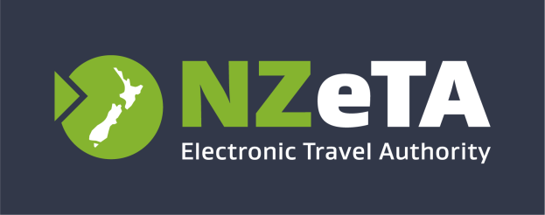


Introducing the New Zealand Electronic Travel Authority (NZeTA)
briefing session for airlines
Notes:
Welcome and introduction
Welcome audience to the session and introduce yourself.
From 1 October 2019, some international visitors and transit passengers must have an NZeTA (New Zealand Electronic Travel Authority) before travelling to New Zealand.

Slide 2


Session Outline
Time (minutes) | Topic
5 minutes | 1. Welcome to your NZeTA briefing session Purpose: To introduce the session and understand the purpose of this briefing session.
10 minutes | 2. What is an NZeTA? Purpose: To recap what an NZeTA is (including the IVL fee), who needs one, how to get one, and what global marketing has occurred to date.
10 minutes | 3. What you need to do Purpose: To explain what check-in staff will need to do to support travellers.
25 minutes | 4. NZeTA Scenarios Purpose: To understand key traveller scenarios and how to support them.
10 minutes | 5. Questions and Wrap-Up Purpose: To summarise pack and ask questions
Total: 1 hour
Notes:
The purpose of this 1 hour briefing session is to ensure:
Airlines are aware of their overall obligations and cooperate with new regulations from 1 October 2019
key messaging (e.g. recapping prior communications and global marketing)is reinforced
and frontline staff (e.g. check in staff, on-the-ground support personnel) know what changes for them and what they need to do differently
Explain: Health and Safety/Evacuation procedures and location of relevant facilities if necessary

Slide 3
What is an NZeTA?

Slide 4
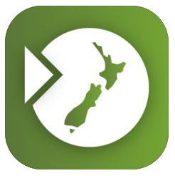
What is an NZeTA?
NZeTA is New Zealand’s Electronic Travel Authority which is a new border security measure being introduced by the New Zealand Government on 1 October 2019.
Some travellers who are eligible to travel to New Zealand without a visa will now be required to hold an NZeTA before their travel to New Zealand.
The NZeTA is not a visa
The NZeTA doesn’t guarantee entry to New Zealand.
Notes:
What is an NZeTA?
The NZeTA is New Zealand’s Electronic Travel Authority which is a new border security measure being introduced by the New Zealand Government on 1 October 2019.
Some travellers who are eligible to travel to New Zealand without a visa will now be required to hold an NZeTA before their travel to New Zealand.
The NZeTA is not a visa and doesn’t guarantee entry to New Zealand. On arrival in New Zealand, travellers must still meet all existing entry requirements, such as holding an onward travel ticket, being a bona fide visitor and being in good health.

Slide 5

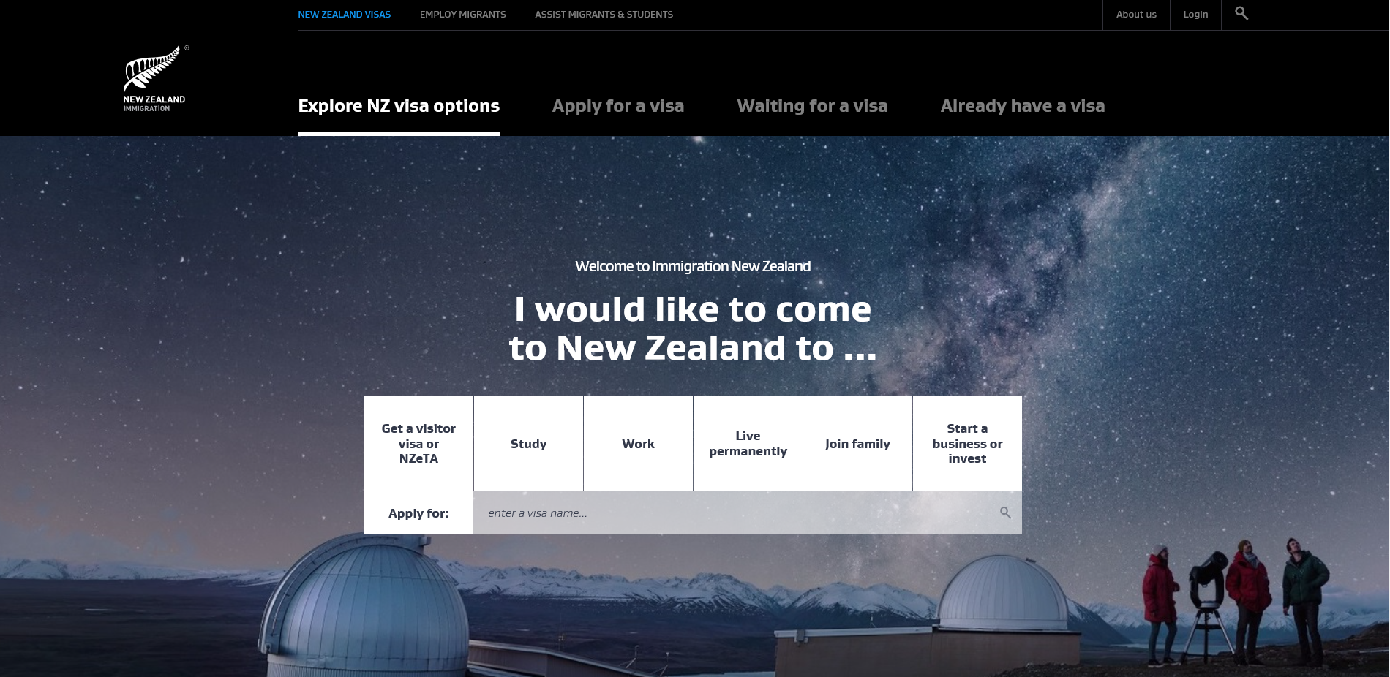
How do travellers request an NZeTA?
NZeTA Mobile App
NZD$9 for NZeTA requests via the mobile app
Web form on immigration.govt.nz
NZD$12 for NZeTA requests via the website form
Once issued, the NZeTA is valid for up to 2 years and can be used for multiple visits.
Notes:
How do travellers request an NZeTA?
Travellers request an NZeTA either using the INZ NZeTA web form or the INZ NZeTA Mobile App.
NZD$9 via the mobile app; NZD$12 via the website.
Once issued, the NZeTA is valid for up to 2 years and can be used for multiple visits.
Travellers should request their NZeTA well in advance of their trip to New Zealand. It can take up to 72 hours for an NZeTA request to be processed.
If a traveller does not hold an NZeTA when they check in, they will not be allowed to board. They may be able to request an NZeTA upon check in, but if Immigration New Zealand cannot process the request in time, or if the request is refused, then they will not be allowed to board – we will cover off more detail about this later in this briefing session.
Requesting an NZeTA is simple, travellers will need their passport and a Visa or MasterCard Credit or Debit card.

Slide 6
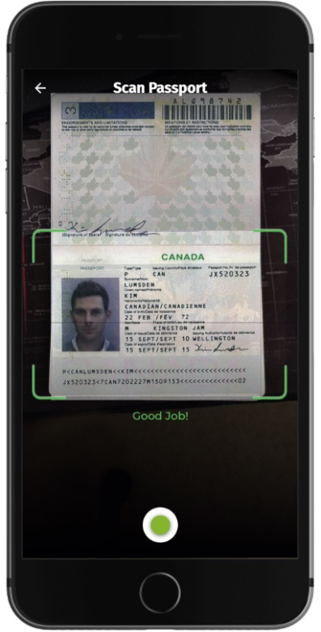
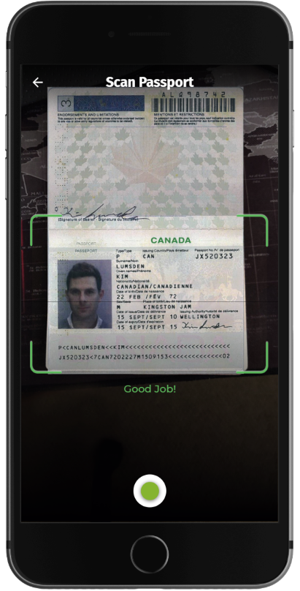
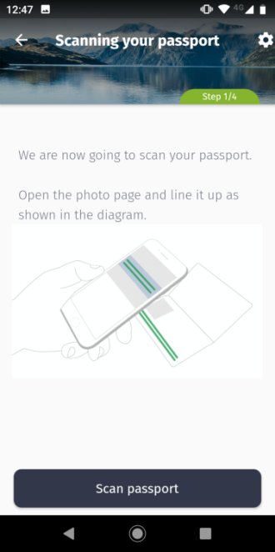

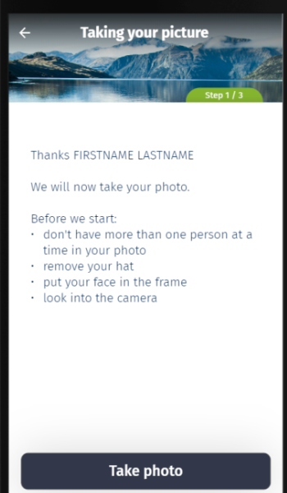
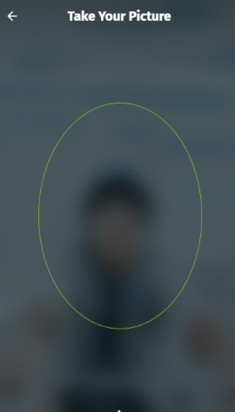
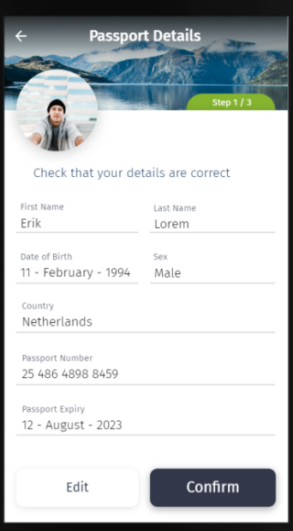

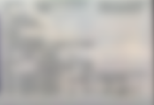
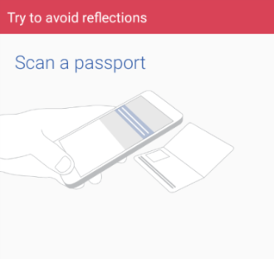
Using the Mobile App
Notes:
New Zealand is the first country in the world to develop an app for an electronic travel authority. It utilises scanning and photo technology to capture passport details, credit card details and to capture your face which makes it really quick and easy for a traveller to request an NZeTA.
Travellers will need their passport and a Visa or MasterCard Credit or Debit card, an email address, a connected device on which to apply and to answer a few simple questions.

Slide 7
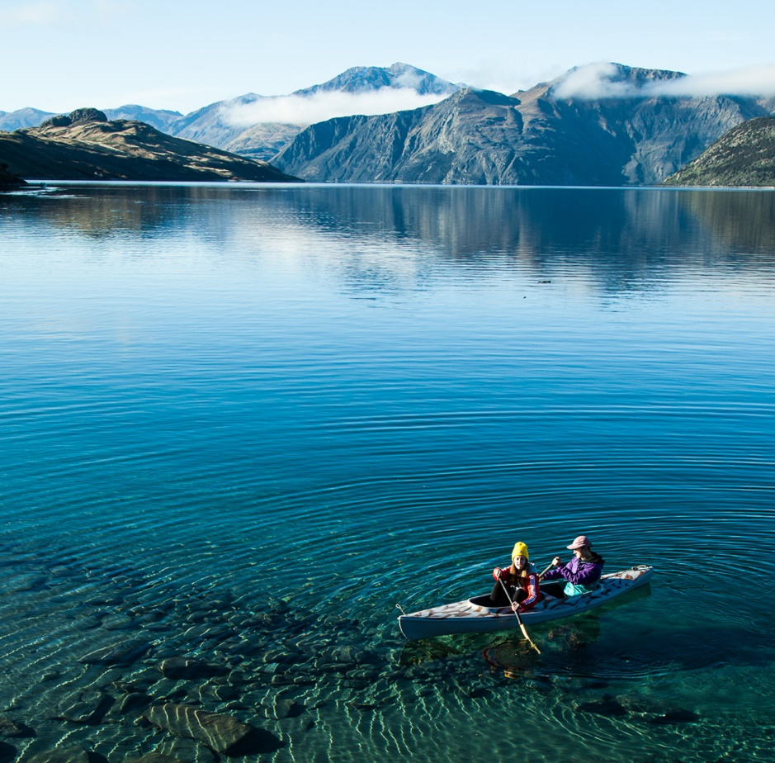
What is the IVL?
International Visitor Conservation and Tourism Levy (IVL) NZD$35 is a way for travellers to contribute directly to the tourism infrastructure they use and help protect the natural environment they enjoy during their stay in New Zealand.
Notes:
What is the IVL?
International Visitor Conservation and Tourism Levy (IVL)
The IVL is a way for travellers to contribute directly to the tourism infrastructure they use and help protect the natural environment they enjoy during their stay in New Zealand.
Most visitors to New Zealand will need to pay the IVL and this payment will be made when they apply for either their visa or request an NZeTA, which may enable multiple entries for one payment. The IVL costs NZD$35 and, if required, will be charged automatically at the time travellers request their NZeTA making it easy for the traveller.

Slide 8
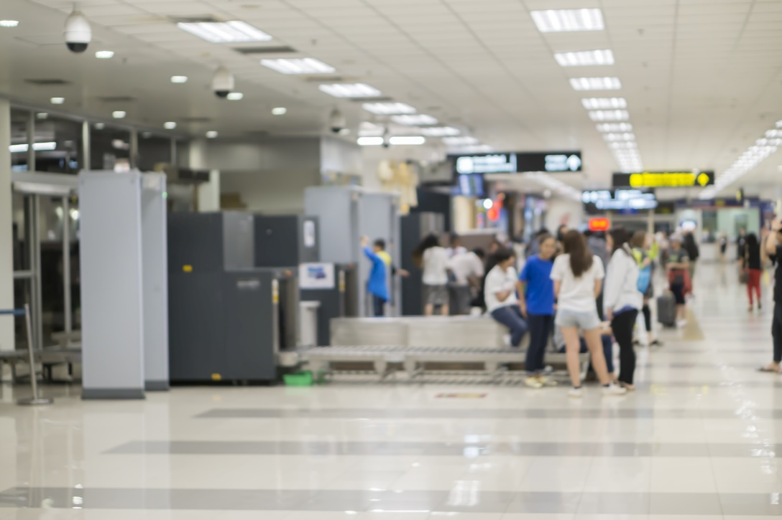
Why is NZ introducing the NZeTA and why does it matter?
Introducing the NZeTA will:
streamline systems for entry which will speed up border clearance
allow more detailed security checks to be performed on people who are coming to visit which will strengthen security and is based on best practice border security systems implemented in other countries.
Notes:
Why is NZ introducing the NZeTA?
In recent years New Zealand has experienced an exponential increase in the number of visitors and currently, visa waiver visitors receive only light-touch screening.
Introducing the NZeTA will:
streamline systems for entry which will speed up border clearance
Allow more detailed security checks to be performed on people who are coming to visit which will strengthen security and is based on best practice border security systems implemented in other countries.
While it is a significant change, we hope that there will be benefits for carriers too, with fewer passengers refused entry to New Zealand at the onshore border (and subsequently turned-around which incurs costs to carriers as well).
Airlines’ responsibilities around NZeTA arises from the airlines’ legal obligations with respect to the Advance Passenger Processing system (APP). Whether or not a traveller holds an NZeTA will be automatically assessed when the person presents at check-in for the flight to NZ, via prescribed data submitted from the airline via APP. The obligation is to submit the required APP data and comply with the boarding instructions received. Airlines should do as they do now – follow the APP instructions. Airlines commit an offence if they fail to comply with ‘Do Not Board’ instructions from APP. This means that the carrier may be infringed or prosecuted if a passenger is boarded when it has received either of these responses.
Of course, where boarding is initially denied, we are keen to ensure all appropriate steps are taken to resolve the issue so that boarding can be permitted (via APP) for bona fide travellers to continue on their journey but we’ll cover that process later in this session.
Remember that INZ is able to exercise its discretion, to allow boarding for passengers in exceptional circumstances. The override procedure is a current process and INZ has recruited a number of additional resources to support any increase post 1 October.

Slide 9
Who needs an NZeTA?
Visitors from 60 visa waiver countries.
Transit* passengers from 24 transit visa waiver countries.
All airline and cruise line crew members (except those with Australian or New Zealand citizenship).
Australian Permanent Residents, who will need to hold an NZeTA.
This equates to around 1.5 million people each year.
Important notes:
*Transit passengers from visa waiver or transit visa waiver countries need an NZeTA to transit through Auckland International Airport, on the way to another country.
People transiting via Auckland International Airport to or from Australia, regardless of nationality, can travel with an NZeTA.
Cruise ship passengers from visa required countries, who are travelling to New Zealand on a cruise ship, can hold either an NZeTA or a visa. If they are flying into New Zealand to meet a cruise ship, they will need to apply for a visa.
Notes:
Who needs an NZeTA?
You are required to hold an NZeTA before travelling
to New Zealand if you are:
• Travelling on a passport from a visa waiver country.
• An Australian permanent resident.
• A cruise ship passenger, regardless of nationality.
If you are a cruise ship passenger from a visa required country, you can visit New Zealand using an NZeTA, but you must be travelling to New Zealand on the cruise ship.
Do visitors in transit also need an NZeTA?
Travellers from visa waiver or transit visa waiver countries who are in transit through Auckland International Airport are required to hold an NZeTA from 1 October 2019, even if New Zealand is not their final destination
People transiting to or from Australia, regardless of nationality, can do this with an NZeTA. This is a benefit for those passengers who would previously have been transit visa required.

Slide 10
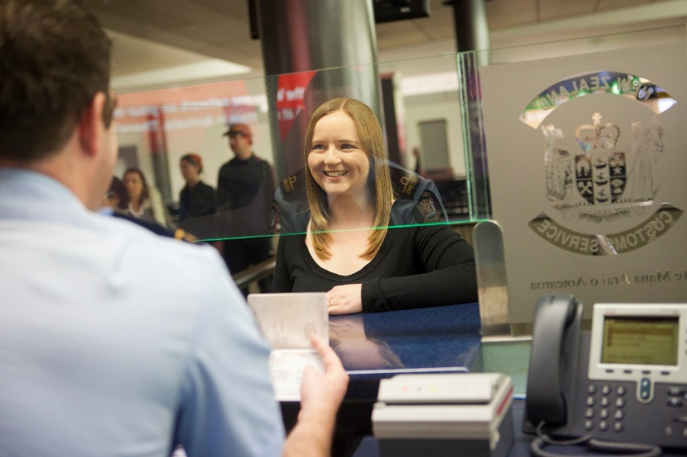
Who does not need an NZeTA?
You do not need an NZeTA if you:
are a New Zealand citizen travelling on:
  a New Zealand passport, or
  a foreign passport that has a New Zealand citizen endorsement
are an Australian citizen travelling on an Australian passport
hold a valid visa for New Zealand — including a Permanent Resident Visa
Notes:
Who does not need an NZeTA?
You do not need an NZeTA if you:
are a New Zealand citizen travelling on:
a New Zealand passport, or
a foreign passport that has a New Zealand citizen endorsement
are an Australian citizen travelling on an Australian passport (including an endorsement indicating Australian citizenship (e.g. Australian declaratory visa).
hold a valid visa for New Zealand — including a Permanent Resident Visa
Then they are eligible to travel to NZ without a visa or NZeTA.
All other passport holders must show evidence of a visa or an NZeTA.

Slide 11
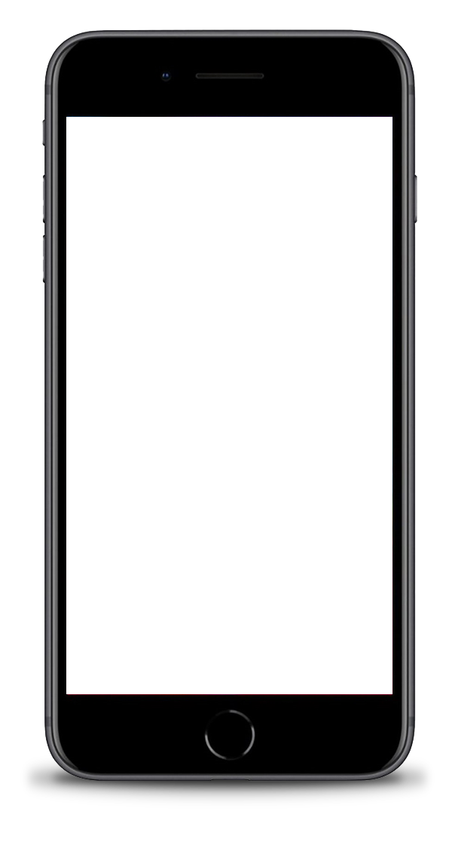
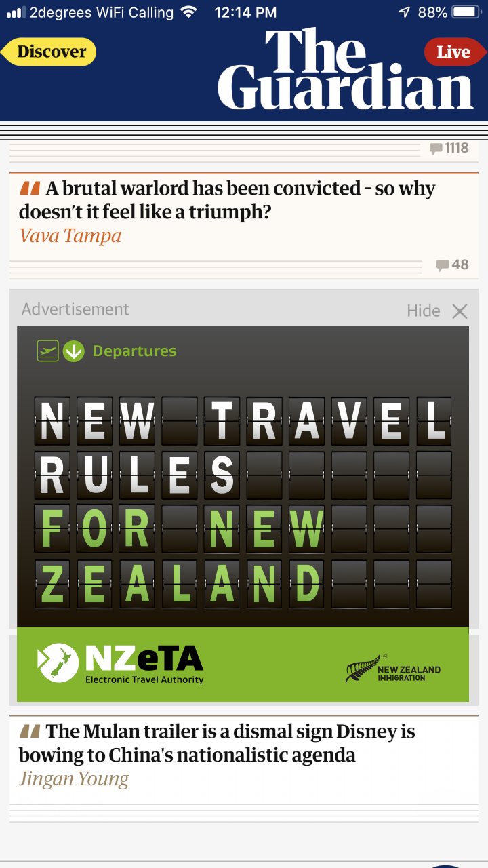
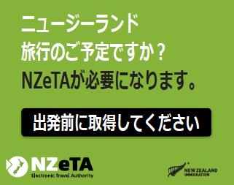
How have we communicated with travellers?
Channels including:
Print
Billboards
Online (display)
Video
Google Search Results
Notes:
How have we communicated with travellers?
A global marketing campaign has been raising awareness of the NZeTA and how it affects New Zealand’s borders.
The campaign kicked off in May, allowing five months to ensure travellers, markets and carriers are well-educated about the NZeTA and what they need to do.
Our activity will reach all of the 60 visa waiver countries, through a mix of paid and unpaid channels.
The top 20 countries, which account for 93% of visitors will be targeted with paid marketing activity, with a focus on cost-effective digital marketing. The top 20 countries, and the remaining 7% of travellers, will also be reached via unpaid communications channels including:
Print
Billboards
Online (display)
Video
Google Search Results

Slide 12
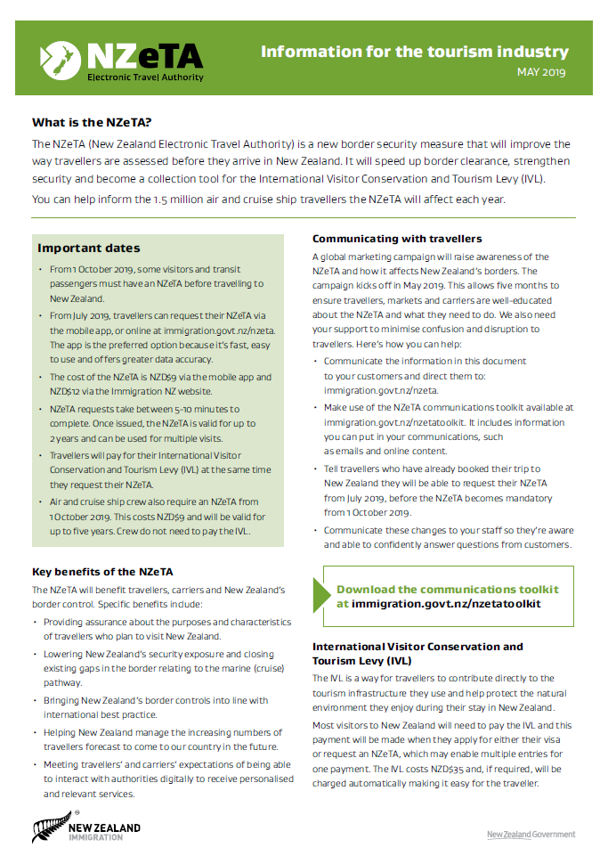
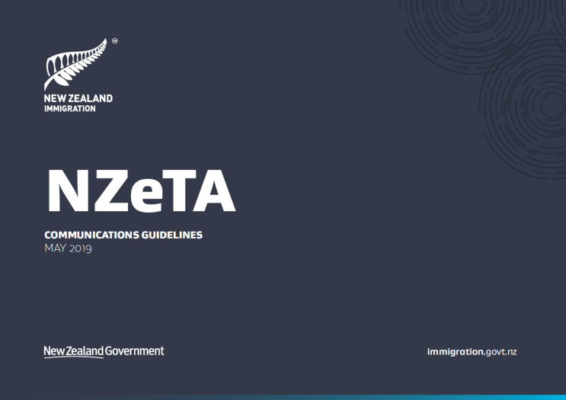
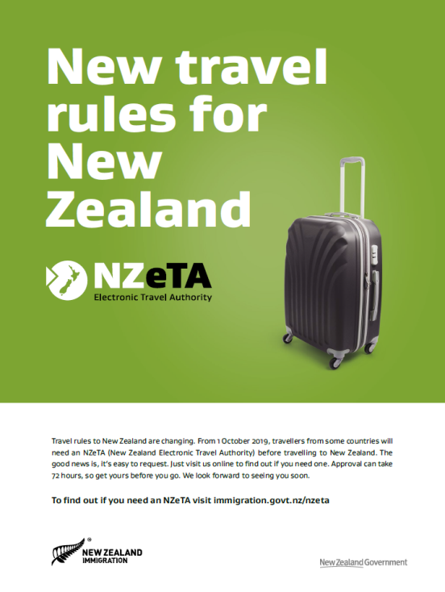
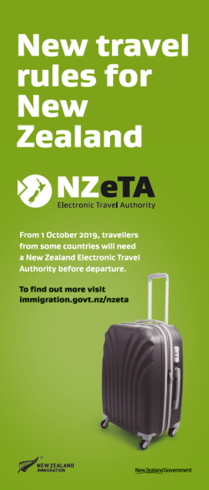
Communication Toolkit
The Communications toolkit has been designed to ensure that the tourism industry have the information and assets they need can communicate with customers.
This includes:
Information sheet for travellers
Information sheet for industry
Communications guidelines
Website and email content
Print magazine advert
Pull up banner
www.immigration.govt.nz/nzetatoolkit
Notes:
Communications Toolkit
This has been designed to ensure that the tourism industry have the information and assets they need can communicate to their customers at the same time that we are running our global marketing campaign for travellers.
Information sheet for travellers
Information sheet for industry
Communications guidelines
Website and email content
Print magazine advert
Emails have been sent out to stakeholders including travel and tourism industry stakeholders, travel agents, government stakeholders and travellers.
The information in the Communication toolkit is designed to help organisations in the tourism industry communicate to their customers about the NZeTA including an information sheet for travellers in 11 languages.

Slide 13
What you need to do

Slide 14
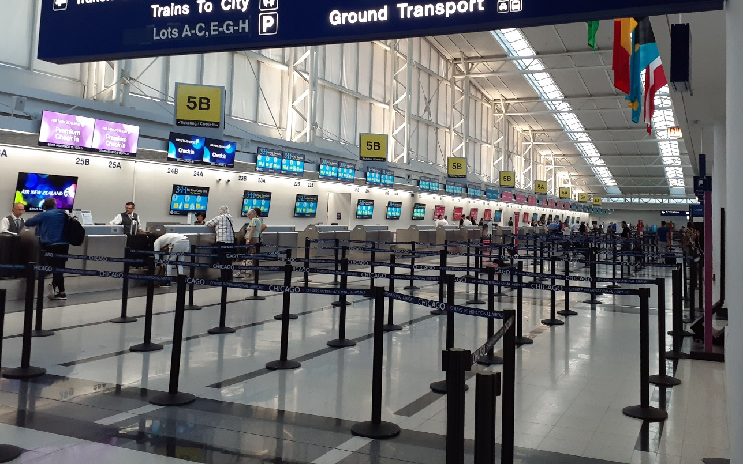
What you need to do to support travellers
From 1 October 2019, the requirement for travellers to hold either a Visa, an NZeTA, or an NZ/AU passport at check-in will be enforced
Check-in staff must continue to follow APP instructions
Notes:
What you need to do to support travellers
INZ is preparing to enforce the requirement for travellers to hold either a Visa, an ETA, or an NZ/AU passport at check-in, from 1 October 2019
Carriers must continue to follow APP instructions

Slide 15
What is not changing?
Obligations for operating APP
Airlines are required to follow the APP instructions for boarding – exactly as they do today – and this is the primary obligation.
Airlines should perform troubleshooting steps before contacting Immigration Border Operations (IBO) if they need any assistance
Board
Notes:
What is not changing?
Obligations for operating APP
Airlines are required to follow the APP instructions for boarding – exactly as they do today – and this is the primary obligation.
Airlines should perform troubleshooting steps contained later in this pack before contacting Immigration Border Operations (IBO) if they need any assistance - as they do today. IBO will have additional staff available to help manage requests for manual processing/intervention.

Slide 16
What is changing?
New APP Response Code
This will clearly indicate the scenario where the passenger is being prevented from boarding, because they do not hold an NZeTA.
Message code: 8525
Brief description: NZ ETA NOT FOUND
Description: Do not Board needs NZ ETA
Action required by airline: Do not allow the passenger to board.
Notes: Advise traveller to immediately request ETA
Denied
Notes:
What is changing?
New APP Response Code
Carriers must continue to follow APP instructions - however, there is an additional response code available, that carriers must use, to better triage ETA-specific issues at check-in.
This will clearly indicate the scenario where the passenger is being prevented from boarding, because they do not hold an NZeTA.
Message code: 8525
Brief description: NZ ETA NOT FOUND
Description: Do not Board needs NZ ETA
Action required by airline: Do not allow the passenger to board.
Notes: Advise traveller to immediately request ETA
MR sent to NZ: Denied Movement Record
In this case you need to assist the traveller to resolve the scenario (i.e., providing first-level support to request the ETA urgently, and retry the check-in) – prior to contacting INZ. There is an Information sheet available in to guide travellers through the request process. We will go into more details in the scenarios later in the session.

Slide 17
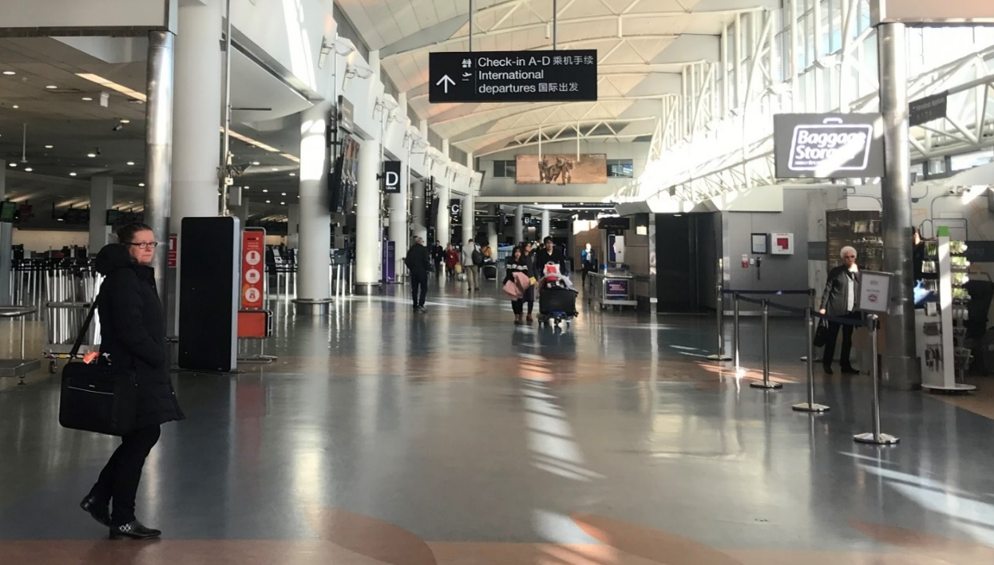
What support will be in place?
Airlines should continue to contact Immigration Border Operations (IBO), for assistance to resolve APP issues (including NZeTA-related issues). Immigration New Zealand will be providing additional resources in IBO to help with APP-related contact from airlines.
There will also be a pack available with resources for check in staff. This will include a flyer with information on how to request an NZeTA for check in staff to provide to travellers.
Notes:
What support will be in place?
Airlines should continue to contact Immigration Border Operations (IBO), for assistance to resolve APP issues (including NZeTA-related issues) as they do today – current process. Immigration New Zealand has recruited and trained additional resources in IBO to help with APP-related contact from airlines.
There will also be a pack available with resources for check in staff. This will include hand-out information to assist check in staff to help travellers request an NZeTA if they try check in without one (e.g. a brochure to explain how to request an NZeTA – this will be in English and 10 languages).
The 10 languages have been selected based on the volume of visitors to New Zealand who speak these languages.
Arabic
Chinese (traditional)
Chinese (simplified)
French
German
Italian
Japanese
Korean
Brazilian Portuguese
Latin American Spanish
The pack may also include resources to allow check in staff to help troubleshoot and triage issues as well as escalations if travellers try to check in without an NZeTA.

Slide 18
NZeTA Scenarios
Notes:
NZeTA Scenarios:
The following scenarios are designed so that check in staff are able to confidently support travellers in the following:
identify which travellers do not hold an NZeTA or those who have been refused an NZeTA
recognise when to escalate a request to Border Operations on behalf of the traveller
how to quickly refer travellers to request an NZeTA.
The key in each of these scenarios is to remember that just as you do today, you must always follow your APP boarding instructions and in any case where you need assistance, call IBO.
Please prepare the 2 x videos to be played in this section.

Slide 19
Notes:
Please play NZeTA SCENARIO ONE video [1:58 minutes] - Separate MP4 file.
Make sure you have sound on.
Transcript below:
Scenario 1: Positive Board response
Kia Ora.
Your traveller checks in, their passport is scanned and the APP response is positive.
The response will either be 8501 OK to BRD or the conditional response 8519 BRD with OWT (Outward ticket).
Your system may translate these responses further however, the responses and processes you follow are the same as today.
A positive board response means the traveller has either got an NZeTA, a visa, or is an Australian or NZ citizen.
This is great news as your traveller can board the plane!

Slide 20
Scenario 1: Discussion Points
What APP response will my airline see?
A positive response will be the most common scenario
Will check in staff see that the traveller has an NZeTA?
What if a traveller checks in at a kiosk or online?
What do check in staff need to do if traveller quotes their NZeTA reference number?
Notes:
You can use these slides to prompt discussion or use as a quiz on the positive board scenario:
A positive response will be the most common scenario.
What APP response will my airline see?
App response codes are: Board Response from APP in this instance = 8501 – OK to BRD Or could be 8519 – BRD with OWT (if outward ticket requirement applies) – incidentally this will be most of the visa-waived / NZeTA travellers. The airline system may translate these responses even further. We recommend that airlines document their translated responses in their own versions of this information.
What if traveller checks in at a kiosk or online?
Your check-in channels will be integrated with APP in order for check in to be complete so the traveller will be able to check in and board with no further issues
Will check in staff see that the traveller has an NZeTA?
No, the APP response will either be positive = Board or negative = Denied Boarding. APP is checking if the traveller is either a NZ or Australian citizen, or has a visa or has an NZeTA based on the standard check-in information
What do check in staff need to do if traveller quotes NZeTA reference number or provides a copy of confirmation email (e.g. on a screen or printed out)?
There is no need for this information if they receive a positive board response

Slide 21
Notes:
Please play NZeTA SCENARIO TWO video [4:55 minutes] - Separate MP4 file
Make sure you have sound on.
Transcript below:
Scenario 2: Negative board response
Kia Ora.
In this scenario your traveller checks in, their passport is scanned and the APP board response is negative.
Depending on how APP is configured for your airline the response will be either “8525 DNB – NO ETA” found or “8520 DNB Contact INZ” (Immigration New Zealand).
8525 is a new code which is available to help airlines troubleshoot NZeTA specific issues at check in.
If your systems are not ready to receive the new code, you will receive the 8520.
There are several reasons a visa-waiver traveller may receive a negative boarding response so you’ll need to follow a few simple troubleshooting steps.
Once you have determined that they are a visa-waiver traveller you will need to ask if they have an NZeTA?
If NO, then advise the traveller to request an NZeTA immediately. There is a flyer available to give to travellers which explains how they can request one (airlines can access this from the NZeTA Communications Toolkit page – www.immigration.govt.nz/nzetatoolkit).
Requesting an NZeTA is a simple process. The traveller only needs their passport, a Visa or MasterCard credit or debit card, an email address, a connected device on which to apply, and to answer a few questions.
Once the traveller has requested their NZeTA and received notification via email or the app that the NZeTA has been issued you can repeat the check in process. Even if they haven’t yet received the notification it’s working checking in anyway as most travellers likely receive an OK to Board response at this point which means they can board the plane and be on their way.
If however, the traveller is still receiving a Do Not Board response, the Immigration Border Operations team (IBO) will need to be contacted to provide assistance.
If your traveller said YES to having an NZeTA, you will need to troubleshoot further to establish why the traveller received a negative boarding response.
Reasons could include:
Their NZeTA is on another passport e.g. if they have dual nationality, or have renewed their passport since requesting the NZeTA
There is a data entry error e.g. name inputted incorrectly
There may be a mismatch between the NZeTA requested and the travel conditions e.g. the traveller may have indicated they are transiting through NZ and they are not or the traveller may have indicated they are an Australian Permanent Resident and they are not.
The traveller may have been refused an NZeTA
Or the traveller may be trying to enter NZ with fraudulent documents
In these cases you will need to contact Immigration Border Operations (IBO). The more information you can provide to IBO (such as an NZeTA request number if the traveller has one), the faster they will be able to assist the traveller.
Travellers may have their NZeTA request number in an email or they may have printed it out. Just as today, IBO will provide assistance and you’ll need to follow their instructions.
So let’s recap. In some scenarios you may need to call for assistance however, the majority of passengers who arrive at check in and receive a Do Not Board response just need to simply request an NZeTA using the mobile App.
By working together , this ensures passengers can board as smoothly as possible and soon be on their way to NZ.

Slide 22
Scenario 2: Discussion Points
Will check in staff see that the traveller has an NZeTA?
What if a traveller checks in at a kiosk or online?
What do check in staff need to do if traveller quotes their NZeTA reference number?
What are some things to look out for if the traveller is denied boarding and they have an NZeTA?
What if a traveller has a valid reason why they are travelling to NZ without an NZeTA?
Notes:
Discussion/quiz points:
What if a traveller checks in at a kiosk or online?
Your check-in channels will be integrated with APP in order for check in to be complete so the traveller will be referred to a check in agent
Will check in staff see that the traveller has an NZeTA?
No, the APP response will either be positive or negative however, there is an additional code (8525 – NO ETA) which provides more information to assist check in staff with troubleshooting – if your organisation has made the necessary changes to receive it. APP is checking if the traveller is either a NZ or Australian citizen, or has a visa or has an NZeTA
What do check in staff need to do if traveller quotes NZeTA reference number or provides a copy of confirmation email (e.g. on a screen or printed out)?
If you need to call IBO, providing the NZeTA request number will be very helpful
What are some things to look out for if the traveller is denied boarding and they have an NZeTA?
-Does the persons passport details match the NZeTA? Has it been renewed?
-Dual nationalities: ask if they have more than one passport?
-Fraud: is the NZeTA genuine? Is the passport genuine?
-Has the NZeTA been refused? Travellers can check this themselves by checking their email or by visiting the ‘Check Your NZeTA status’ page at www.immigration.govt.nz/nzeta
-Is the NZeTA a transit only NZeTA? If travellers are intending on visiting NZ they need to request a standard NZeTA (non-transit).
What if a traveller has a valid reason why they are travelling to NZ without an NZeTA (e.g. could be considered a humanitarian/emergency case, unaccompanied minor with no access to a credit card etc.)?
IBO will assess these situations on a case-by-case basis. As today, you need to follow their instructions.

Slide 23
Questions and Wrap-Up

Slide 24
Recap key points
The NZeTA is an authority to travel and does not guarantee entry to NZ.
You must follow your APP boarding instructions, as you do today
There is a new APP response code 8525 – NZeTA not found
If a passenger does not have an NZeTA, then they should be directed to apply for one and to re-check in.
If you need assistance please call IBO as you do today
If there is an APP outage please follow your normal outage procedures
Notes:
Recap – key points
The NZeTA is an authority to travel and does not guarantee entry
You must follow your APP boarding instructions as you do today
There is a new APP response code 8525 – NZeTA not found
If a passenger does not have an NZeTA, then they should be directed to apply for one. In most cases the NZeTA will be issued
If you need assistance please call IBO as you do today
If there is a an APP outage please follow your normal outage procedures
For more information please visit New Zealand’s Immigration website: www.immigration.govt.nz/nzeta

Slide 25
Key Contacts
NEW ZEALAND’S IMMIGRATION WEBSITE:
www.immigration.govt.nz/nzeta
IMMIGRATION BORDER OPERATIONS (IBO) – for airline use only:
Phone: +64 9 2771250 (24x7 APP hotline)
Email: apsso@mbie.govt.nz
SITA: AKLAPXH

Slide 26

Any Questions?
Notes:
Questions
Ask the audience if they have any questions about anything they have covered in the session and discuss.
Ask the audience reflect on the session and show how confident they are on a scale of 1-10 about how they will support NZeTA traveller scenarios?
Provide any support that is necessary.
Presenters/speakers: please feedback to the ETA Project if there are any issues or concerns raised during your briefing session or from other engagement you have with airlines/staff: nzeta.information@mbie.govt.nz (email not for external use).

Slide 27
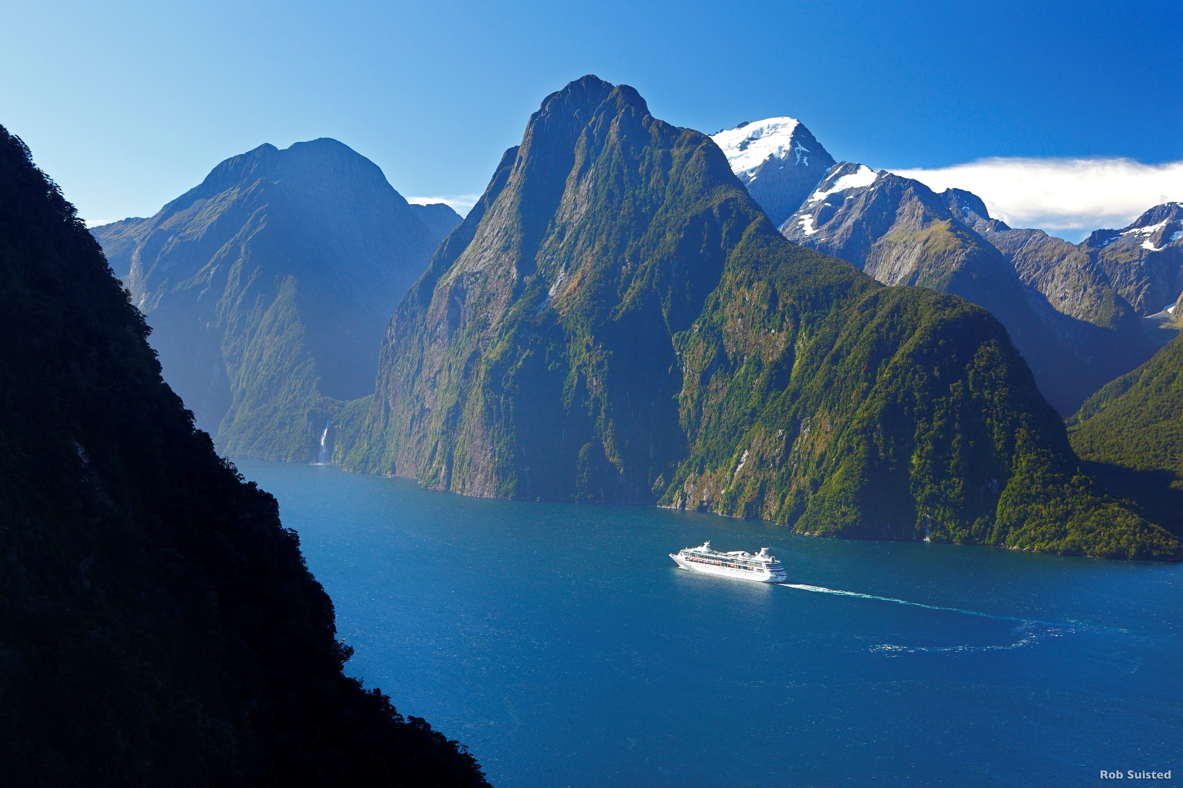
Kia Ora
and thank you for your time.
Notes:
Wrap up
Thank the audience for their time.

Slide 28
Appendices

Slide 29
Principles for handling ‘Do Not Board’ responses
The general principles and expectations for handling of the ‘No NZeTA’ scenario are outlined below.
Carriers will need to use these principles, as a basis for developing workflow and standard operating procedures to handle this scenario.
Traveller
>72 hrs prior to travel
1. Check in
Determine traveller doesn’t have NZeTA
2. Request NZeTA
Advise traveller to request NZeTA
3. Repeat Check in
On basis traveller now has NZeTA
4. Contact INZ
If traveller is still not OK to Board
Travellers who are required to hold an NZeTA are advised to request an NZeTA a minimum of 72h hours prior to travel.
Airlines may assist a traveller to attempt to obtain an NZeTA at check in however, a response is not guaranteed within 72 hours.
Traveller may self-identify that they don’t have an NZeTA
Airline staff may ask the traveller prior to check in
On check in (desk, kiosk, online), APP receives a Do Not Board – No ETA or Do Not Board response
Check in agent may identify an invalid combination e.g. transit NZeTA for destination travel, renewed passport, or fraudulent documents
Provide traveller with ‘How to Request an NZeTA’ flyer
Direct traveller to request an NZeTA via mobile app
Travellers need: passport, Visa/MasterCard credit or debit card, email address, and a connected device on which to apply.
Airlines may provide one-on-one assistance or provide devices to assist the traveller.
Once traveller has requested their NZeTA, the check in agent should repeat the check in process.
Many travellers will receive an OK to Board at this point.
If traveller is still receiving a Do Not Board, Immigration Border Operations (IBO) can be contacted to provide assistance. Provide NZeTA request number if possible.
IBO may be able to assist with NZeTA mismatch situations, resolve data-entry issues, or may advise traveller is unable to travel at this time. Government override may be an option exceptional circumstances.

Slide 30
Who needs an NZeTA matrix
A traveller boarding an aircraft or cruise ship that is travelling to New Zealand must hold either: A New Zealand passport OR an Australian passport OR an NZeTA or an existing VISA
 | Travelling to NZ by air | Transiting NZ (Auckland International Airport only) by air (where the destination or origin of travel is Australia) | Transiting NZ (Auckland International Airport only) by air (where the destination or origin of travel is NOT Australia) | Travelling to NZ by cruise ship
NZ or Aus Passport | n/a | n/a | n/a | n/a
Visa-Waiver | NZeTA* | NZeTA* | NZeTA* | NZeTA*
Visa-Waiver Transit | N/A | NZeTA* | NZeTA* | NZeTA*
Visa required | VISA | NZeTA* | VISA | NZeTA**
*If a traveller already holds a NZ Visa with valid travel conditions, they do not require an NZeTA
**A Visa required passenger who is flying to NZ to join a cruise MUST apply for a visa in advance of travel

Slide 31
List of visa waiver countries and territories (60) as at 1 October 2019 – for an up to date list please visit www.immigration.govt.nz/nzeta
Andorra Argentina Austria Bahrain Belgium Brazil Brunei Bulgaria Canada Chile Croatia Cyprus Czech Republic Denmark Estonia (citizens only) Finland France Germany | 19. Greece 20. Hong Kong (residents with HKSAR or British National (Overseas) passports only) 21. Hungary 22. Iceland 23. Ireland 24. Israel 25. Italy 26. Japan 27. Korea (South) 28. Kuwait 29. Latvia (citizens only) 30. Liechtenstein 31. Lithuania (citizens only) 32. Luxembourg 33. Malaysia | 34. Macau (Macau Special Administrative Region passports only) 35. Malta 36. Mauritius 37. Mexico 38. Monaco 39. Netherlands 40. Norway 41. Oman 42. Poland 43. Portugal (with the right to live permanently in Portugal) 44. Qatar 45. Romania 46. San Marino 47. Saudi Arabia 48. Seychelles | 49. Singapore 50. Slovak Republic 51. Slovenia 52. Spain 53. Sweden 54. Switzerland 55. Taiwan (permanent residents only) 56. United Arab Emirates 57. United Kingdom (must have the right to reside permanently in the United Kingdom) 58. United States of America (includes USA nationals) 59. Uruguay 60. Vatican City

Slide 32
List of transit visa waiver countries (24) as at 1 October 2019 – for an up to date list please visit www.immigration.govt.nz/nzeta
Bahamas Bermuda Bolivia Colombia Costa Rica Ecuador Federated States of Micronesia Indonesia Kiribati Nauru Palau Panama
Papua New Guinea Paraguay Peru Philippines Republic of Marshall Islands Samoa Solomon Islands Thailand Tonga Tuvalu Vanuatu Venezuela

Slide 33
Exemptions
The following groups will be eligible to request an exemption or a fee-free NZeTA and will also be exempt from paying the IVL.
Antarctic Treaty personnel
Military personnel
Guests of Government
APEC Business Travel Card (ABTC) holders
Officials meeting with or being hosted by a New Zealand Ministry or department
Diplomats transiting through Auckland International Airport.
Travellers who already hold a valid New Zealand visa will not be required to hold an NZeTA or to request an exemption.
Immigration New Zealand is working with a range of partners including the Ministry of Foreign Affairs, Antarctic New Zealand, New Zealand Defence Force and the Diplomatic Corps. to facilitate NZeTA exemptions.

