Slide 1
UNHCR Overview on Current Global
Refugee Resettlement

Slide 2
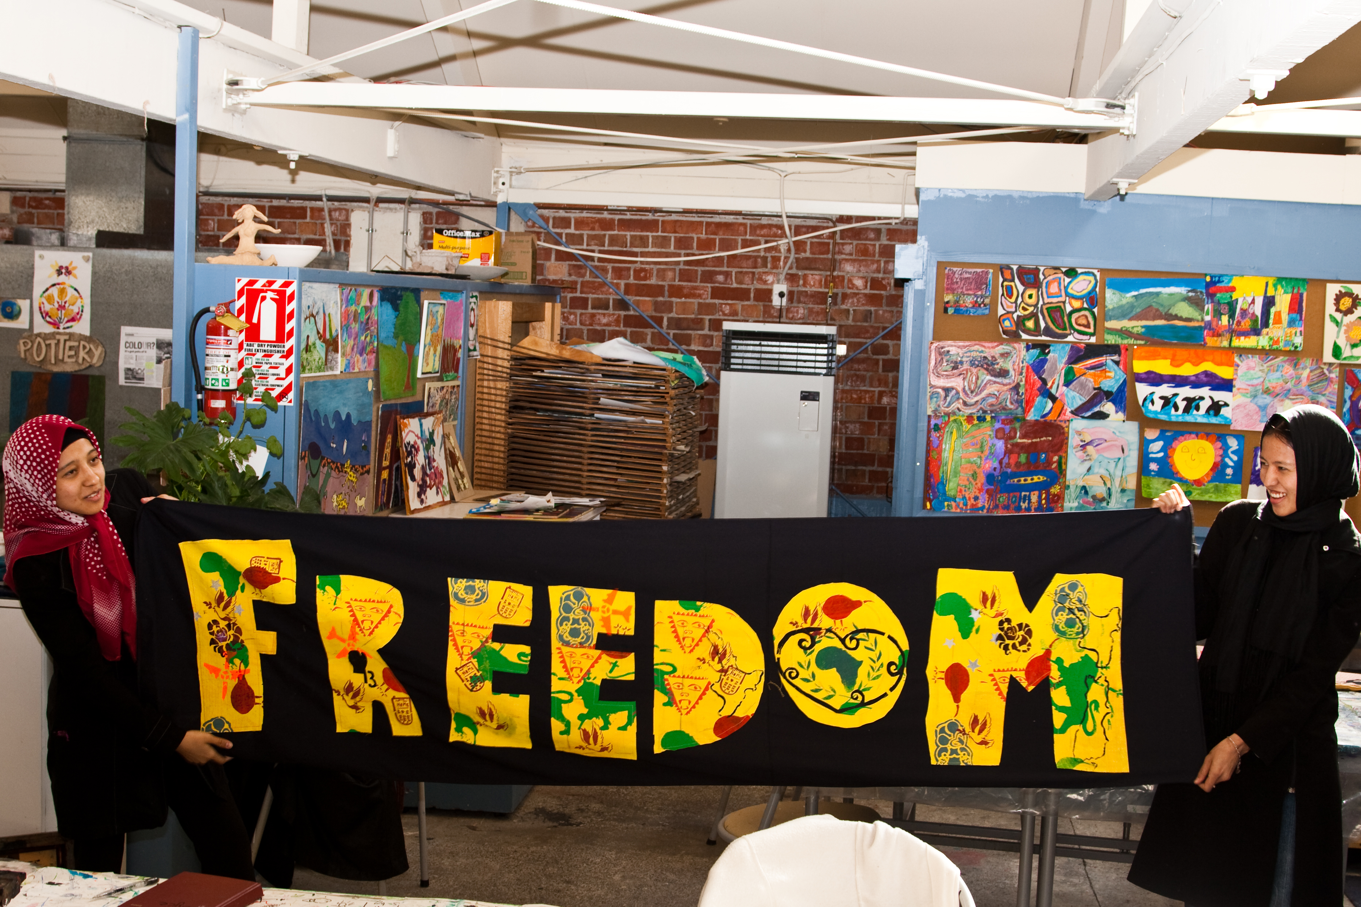
Introduction

Slide 3
Introduction
2016: global resettlement at 20-year high
over 162,000 refugees referred by UNHCR
almost 126,000 able to depart and
start building a new life in their new home country

Slide 4

Resettlement opportunities and achievements

Slide 5
Resettlement opportunities and achievements
2012: 74,800 submissions
2015: 134,000 submissions
2016: 162,500 submissions

Slide 6
Resettlement opportunities and achievements
Increase of 21% in 2016 compared to 2015
Doubling+ of resettlement submissions since 2012

Slide 7
Resettlement opportunities and achievements
Middle East and North Africa: 67,400 (41%)
Africa: 44,000 (27%)
Europe: 29,200 (18%)
Asia and Pacific: 20,700 (13%)
America: 1,300 (<1%)

Slide 8
Resettlement opportunities and achievements
legal and physical protection needs: 33%
survivors of violence and/or torture: 29%
lack of alternative durable solutions: 19%
women and girls at risk: 10%

Slide 9
Resettlement opportunities and achievements
Syrian refugees submitted
2016: 77,200
2015: 53,300
Since 2013: 157,000

Slide 10
Resettlement opportunities and achievements
Democratic Republic of Congo
second top country of origin for resettlement
22,800 refugees referred in 2016
Since 2012
over 80,000 Congolese refugees submitted

Slide 11
Resettlement opportunities and achievements
Other top countries of origin in 2016:
Iraq: 12,800
Somalia: 10,500
Myanmar: 10,100
Sudan: 5,400
Bhutan: 5,400

Slide 12
Resettlement opportunities and achievements
125,600 refugees
were able to depart and
start a new life through resettlement in 2016

Slide 13
Resettlement opportunities and achievements
www.unhcr.org/resettlement-data.html

Slide 14
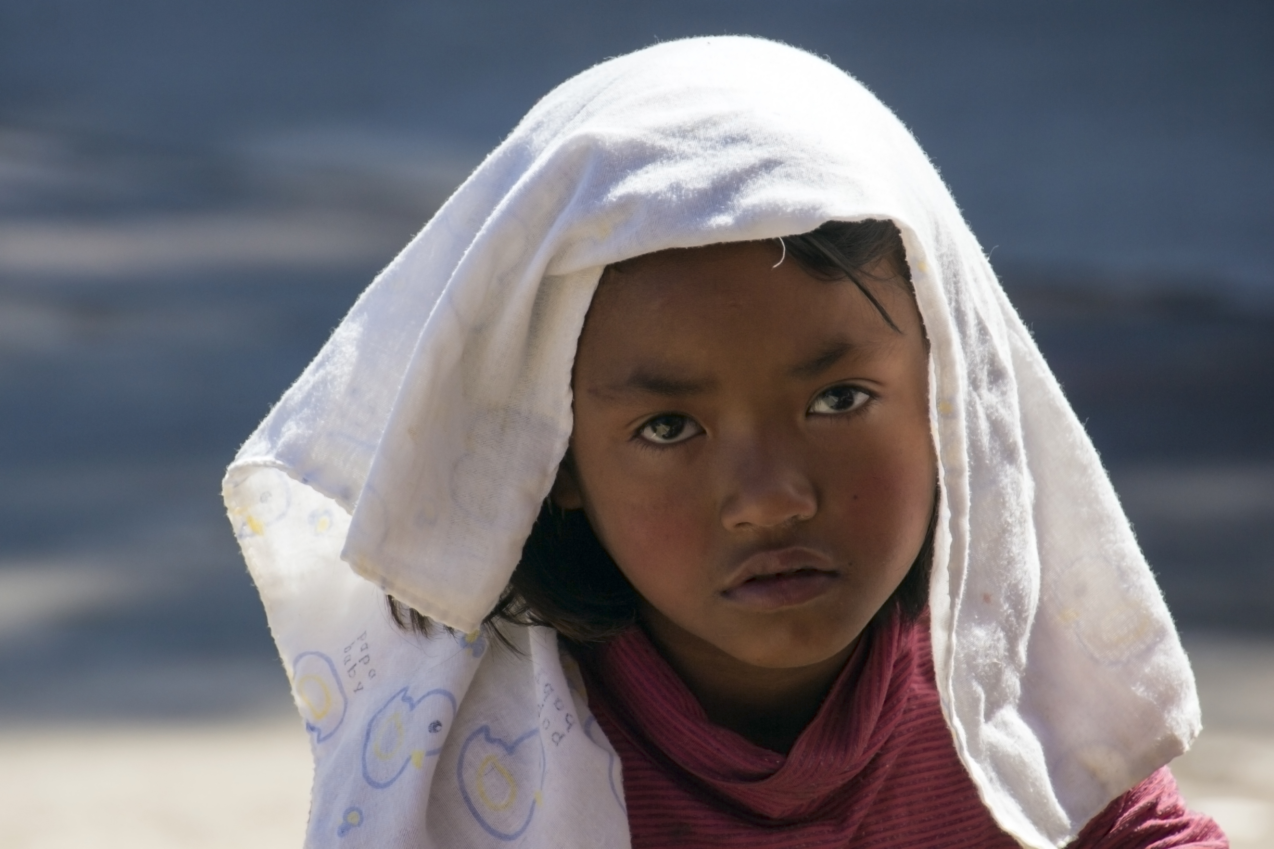
Strengthening resettlement processing

Slide 15

Capacity building and partnership

Slide 16
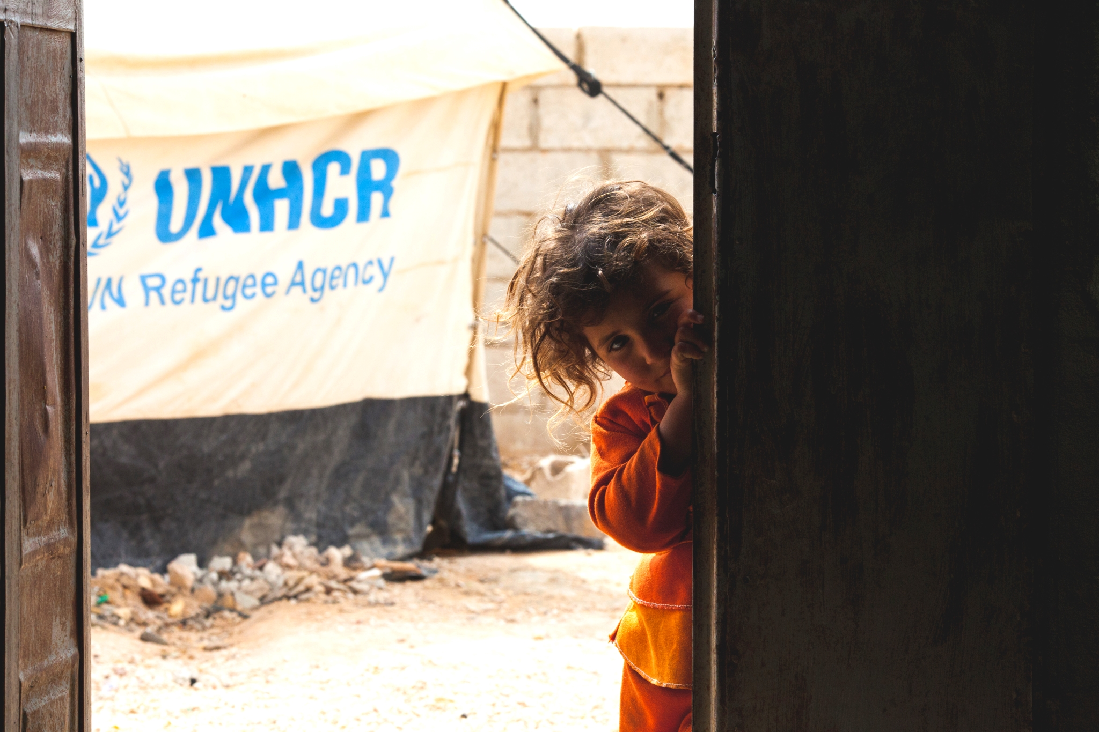
Conclusions

Slide 17
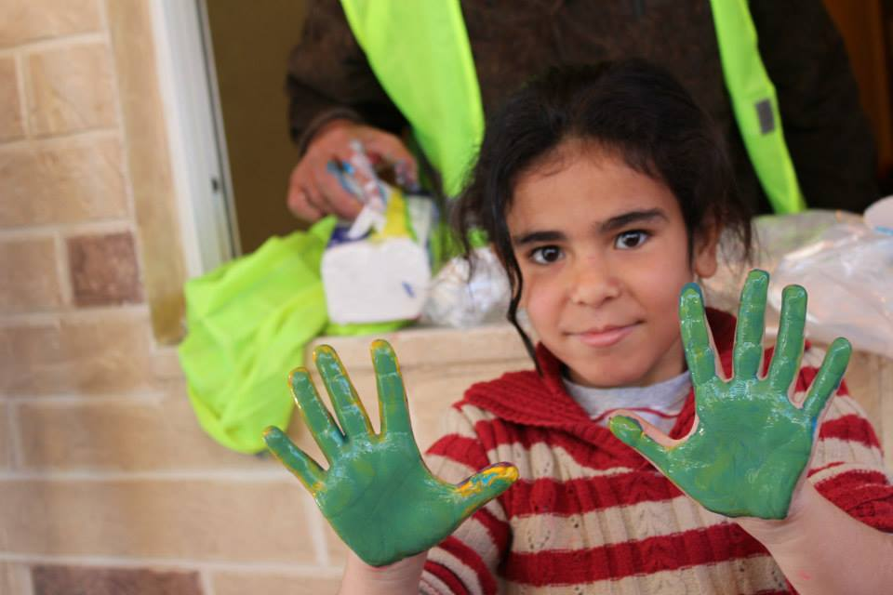
Thank you!

