Slide 1
Health & wellbeing: connecting within and across the health system
24 May 2017

Slide 2
What I will cover today
  Our Health System
  The New Zealand Health Strategy
  Our Future

Slide 3
Determinants of health and wellbeing
J.M. McGinnis et al., “The Case for More Active Policy Attention to Health Promotion,” Health Affairs 21, no. 2 (2002):78–93
Notes:
This is worth remembering
Currently most of our though and effort goes into clinical care
Of late genomic and precision medicine is picking up its pace
On the behaviour choices – more technology such as wearables, sensors and apps are getting easier to use. Also Big Data Analytics on multiple sources of data is starting to help us get better understanding on how to support people behaviour choices
On the data and informatics front we need to ensure that we are joining up and looking at the much broader datasets and understand the role of BDA
NEXT SLIDE . Challenges we know

Slide 4
Current system
  Public health system funded by taxation
  20% of Government’s annual operating budget
  Hospital treatments – free
  Primary care – subsidised
  Maternity & well child services – free
  Aged care services - subsidised
  Pharmaceuticals – subsidised
  Dental care – free up to certain age
  Screening services – free
  Public health services: prevent, protect, promote

Slide 5
Current system - Challenges
  Unfinished business (quality, access, waiting time, co- payment, outcomes)
  Shifting burden of diseases (lifestyle & life-long)
  National emergencies- pandemics, earthquakes, floods
  Finding your way around the system
  Demographics, social norms, political, economic, environmental & climate
  Public expectations & digital consumers
  Rapid changes in Technology & Knowledge

Slide 6
Current system – Challenges for Refugees
  Culture & values
  Language
  Environment
  Experience & journey
  Expectations

Slide 7
Complex change
Volatile
Fast pace
Disruptive
Scale
Impact
Multiple drivers
Constant change
Smaller window
Converge
Unpredictable

Slide 8
Demographics
  Total population
      2013 – 4.4m
      2016 – 4.7m
      2043 – 6.5m*
  * (upper end 90% probability)

Slide 9
Demographics cont.
  Total population 2016
  In 2016, the population grew by 97,300 or 2% to 4.7m, that’s twice the population of Invercargill
  The growth is made up of net birth & death (28,200) and net migration (69,100)
Year | Age - 65+ | Age 15 - 39
1996 | 11.5% | 38.4%
2016 | 15% | 33.7%
2043 | 23% | 30.1%

Slide 10
Demographics cont.
  Ethnicity
  Maori, Pacific & Asian populations will all increase their share of the total NZ population because of their higher growth rates (36%, 43%, 52%)
  Increased overlapping ethnicities - more people identifying with more than one ethnic group
  Distribution
  The Auckland region will grow from 1.5m (2013) to 2.3m (2043)
  Auckland will increase from 34% of NZ (2013) to 39% (2043)
Notes:
2013, mid 2020s, 2038
European (75%,70%,66%)
Maori, Pacific & Asian (36%,43%,52%)
Increasing overlapping ethnicities (12%,14%,19%)..over 30 yrs age group.

Slide 11
Digital consumer
Digital Consumer
Digital
Demonetise
Democratise
Transactions digitised
More accessible
More affordable

Slide 12
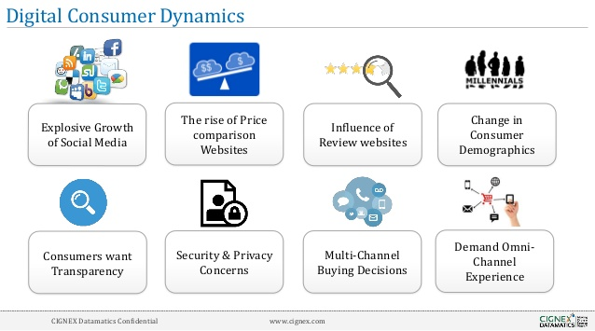
Digital consumer cont.

Slide 13

Technology & knowledge – 3 Clusters
PHYSICAL – robotics, 3D printing, new materials, wearables & sensors
BIOLOGICAL– genomic, proteomic, metabolomics & microbiomic
DIGITAL – cloud computing, Big data, IoTs, Blockchain & quantum computing
“Convergence – artificial intelligence”

Slide 14
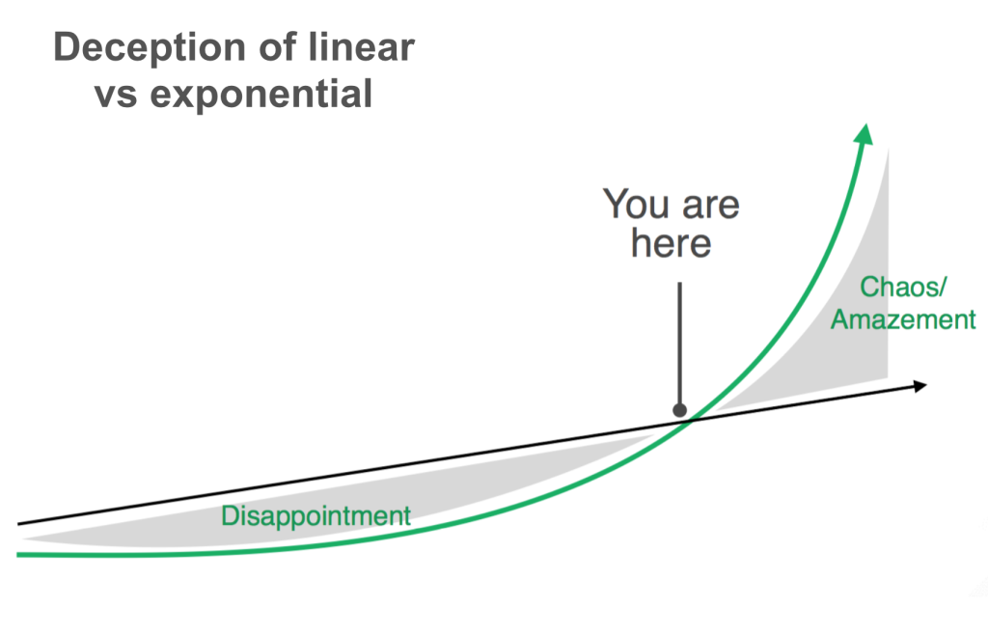
Technology & knowledge - exponential

Slide 15






Scale, Scope & Speed of Disruption
vs.
        vs.
vs.

Slide 16








Disrupting the Disruptors
DISRUPTOR 1.0
DISRUPTOR 2.0

Slide 17
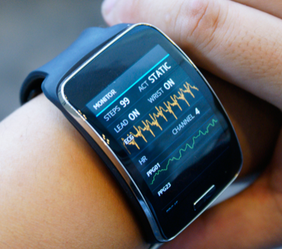
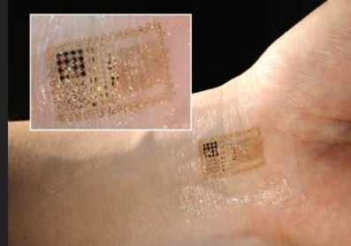

Diagnostic Wearables & Sensors
NOW
10 years
3 to 5 years

Slide 18
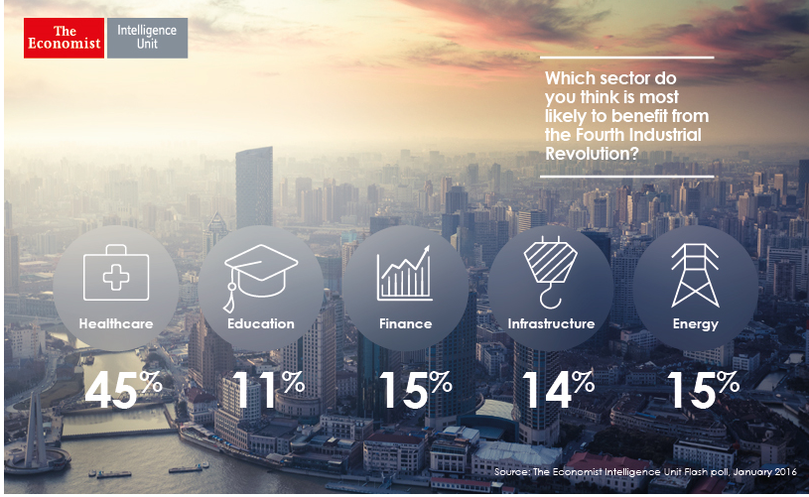
Readiness
  BUT… Healthcare is least prepared to realise the benefit…only 38% say they are very or fairly well ready to harness new technologies

Slide 19
Disruption - workforce
65% of today’s schoolchildren will be employed in jobs yet to be created. (U.S. Department of Labor report)
By 2029 robots will have reached human levels of intelligence (Ray Kurzweil, director of engineering at Google)
33% of jobs will be replaced by software, robots, and smart machines by 2025. (Gartner)
50% of jobs done by humans to be replaced by robots and AI in next 10 years. (Kai Fu Lee, founder Sinovation Ventures, reputable Chinese technologist)

Slide 20


NZ Health Strategy – April 2016

Slide 21
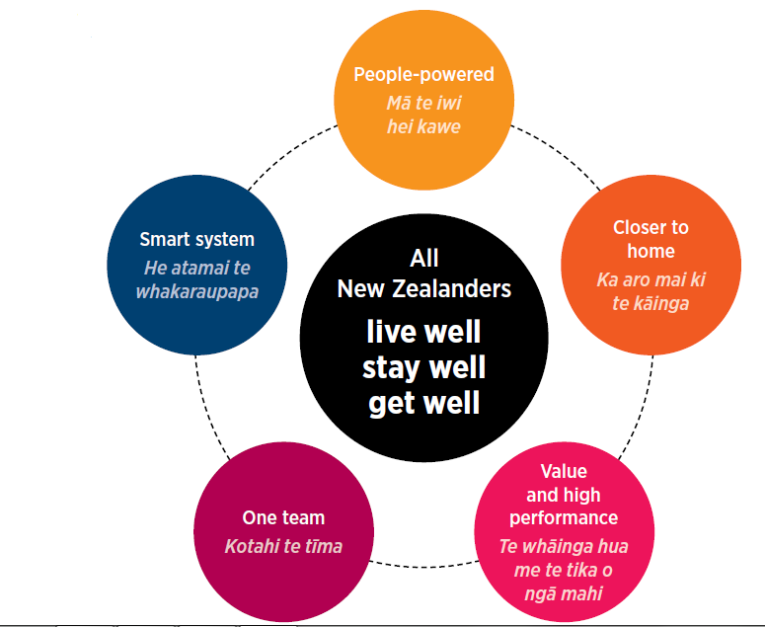

Future direction - next 10 years

Slide 22
Future system
  People/citizens at the centre
  Digital platform
  Connected with other public services
  Connected with private services

Slide 23
Refugee Health & Wellbeing - partners
  Whole person & family
  Wellbeing & care
  Context & culture
  Co-design & digital platform
  Be aware of the rapid changes

Slide 24
Refugee Health & Wellbeing- fellow travellers
  Find & build your networks
  Be deliberate
  Be bold, open & respectful
  Look & volunteer for the disruptive change

Slide 25

Closing word – Atul Gawande
  “We’ve been wrong about what our job is in medicine. We think it is to ensure health and survival. It is to enable wellbeing … therefore it is about the reasons one wishes to be alive.”

Slide 26
  Thank you

